Slide 1
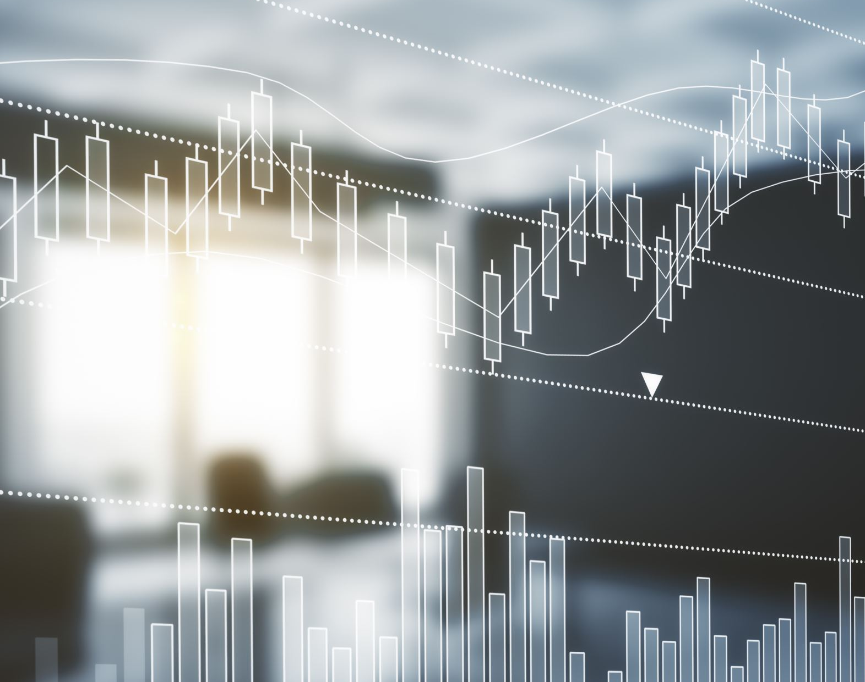

The Rise of Digital Marketing

Slide 2
Our Marketing Strategies
Local marketing - Village campaign, loan mela, shop visit, home visit and pamphlet and brochure distribution
Consumer connect - Door-to-door awareness campaigns in villages and at gram panchayat levels with emphasis on establishing personal connect
Celebrity allure - Many renowned celebrities from the Indian film industry have endorsed our brand including Venkatesh, Mohan Lal, Puneeth Rajkumar, Vikram, Akshay Kumar, Jeet, Sachin Khedekar and Uttam Mohanty
Digital campaigns - OGL Lite application, along with various advertisements and outreach activities on social media

Slide 3
COVID impact and newer opportunities
COVID has already caused huge unrest in the global economy. For the first time in the history of mankind more than 70% of countries are under lockdown.
India had undergone complete lockdown procedures from March end. According to experts, this situation is going to persist for longer periods and individuals and firms need to adapt for the newer normal.
Our company has taken a major hit because of COVID since most of our operations and marketing strategies involves onsite office activities and face to face social interactions.
To adapt for the newer normal, we need to venture out for newer opportunities.
One such thing is we need to leverage the increasing internet usage population and align our strategies accordingly.
India’s current internet penetration rate is at 50% and expected to reach 60% by 2023. To put this into comparison internet penetration rate was at 4% in 2007.
Just during COVID period, consumers from 35 to 44 age bracket increased their internet consumption by 11% while millennials observed an average increase of 5-7%.
Similarly, prominent platforms such as Facebook (+18%), TikTok (+20%), Instagram (+20%), and Whatsapp (+17%) have all witnessed rises in the number of sessions per week per user as per data source.

Slide 4
Digital marketing
We can consider extensive digital marketing, fueled by rapid internet penetration and COVID situation as one of our long-term strategies.
Digital Marketing: component of marketing that utilizes internet and online based digital technologies such as desktop computers, mobile phones and other digital media and platforms to promote products and services
Rise in the internet usage population in India has given an enormous boost for digital marketing and it growing at a rate of 25-30% in India annually.
Despite the disruption of traditional marketing strategies, digital marketing channels are still dominating in the current scenario.

Slide 5
Advantages of digital marketing
It offers new marketing channels that are entirely online and therefore immune to the COVID-19 social distancing consequences.
Customers leave a forensic trail of evidence in the form of digital data that enables storing, tracking, and monetizing every marketing campaign through its channels.

Slide 6
Available options
Organic Search
This is when someone enters a set of words or voice prompts into a search engine and consequently gets directed to online content. When one visits that content, it is considered organic traffic. The site owner does not have to pay a fee to the search engine company for this traffic.
Direct
These are users directly visiting your site. Customer simply type the web address in my browser or click on a bookmark that I have saved there. This is considered direct traffic.
Social
Social media platforms include Facebook, Instagram, LinkedIn, YouTube and Twitter. When people are checking their social media pages, they may see a posting about your company, product, or service with a Learn More link. When they click on it, it will take them to your website. This traffic is tagged as social traffic.
Email
This is the traffic generated by your outbound email campaigns and email interactions. Someone for instance sees a link embedded in the email, clicks on it, and it takes them to your website. That is considered email traffic.
Referral
This is referred traffic from one website to another. It is akin to word-of-mouth, but between websites. When backlinks and citations are present on others’ sites back to your site, they will generate traffic flow to your site.
Paid Search
This includes banner ads, Pay Per Click, social media posts boosts, GeoMarketing, GeoFencing, etc. Unlike organic traffic, they require you to pay for each ad, each display, each visit or each conversion.
Affiliate programs and third-party resellers
Consider adding online affiliates to promote your products and services. You will have to give up a percentage on each sale that comes through these channels. But that may be better than paying upfront for ads when your cash flow is dwindling.

Slide 7
Impact on our company
Long term growth and sustainability
Helps us to venture into new segments
Inline with our online disbursals' strategy

